Slide 1
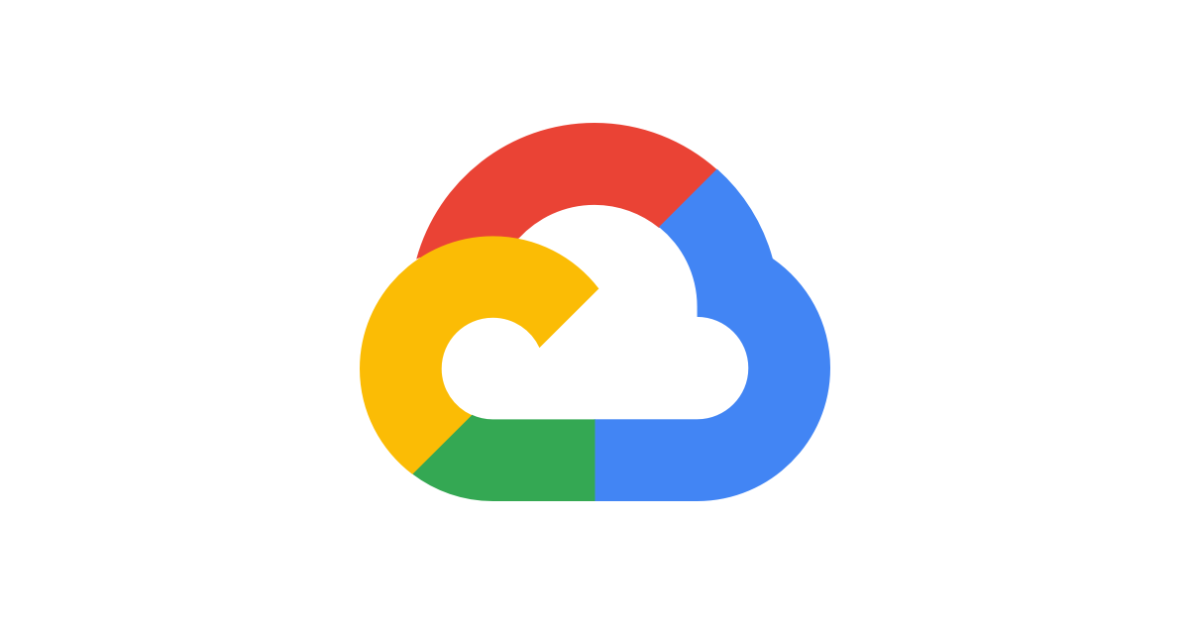

Google Cloud
Account

Slide 2
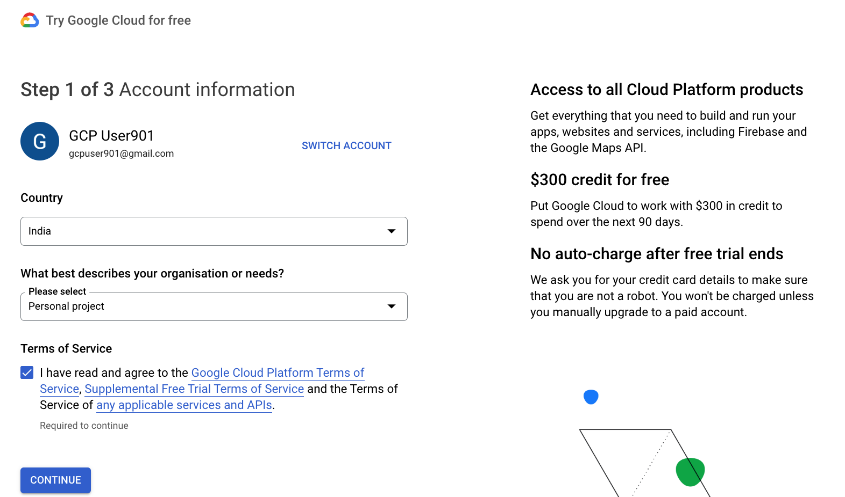
Google Cloud Account

Slide 3
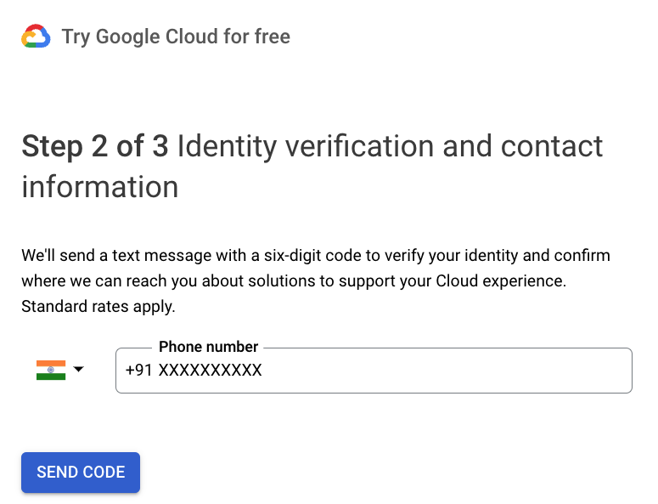
Google Cloud Account

Slide 4
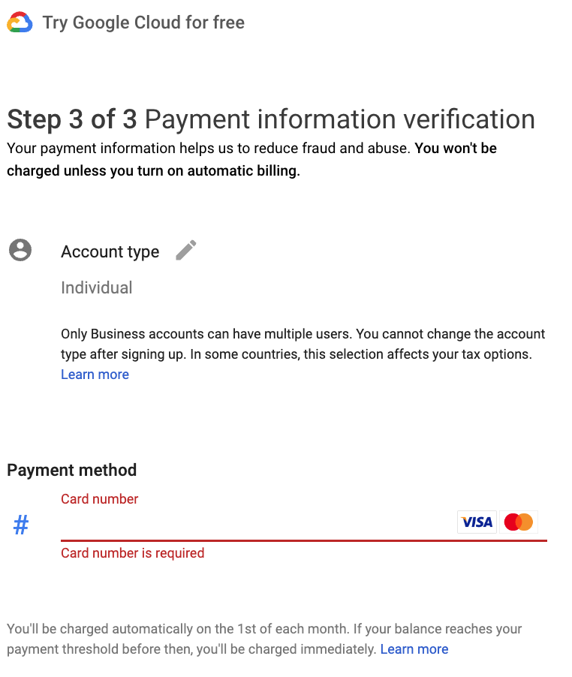
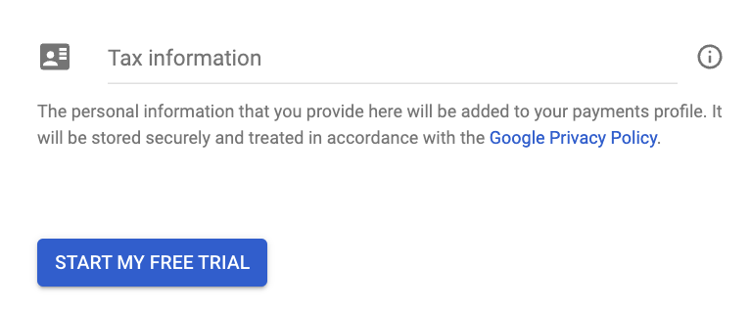
Google Cloud Account - Individual

Slide 5
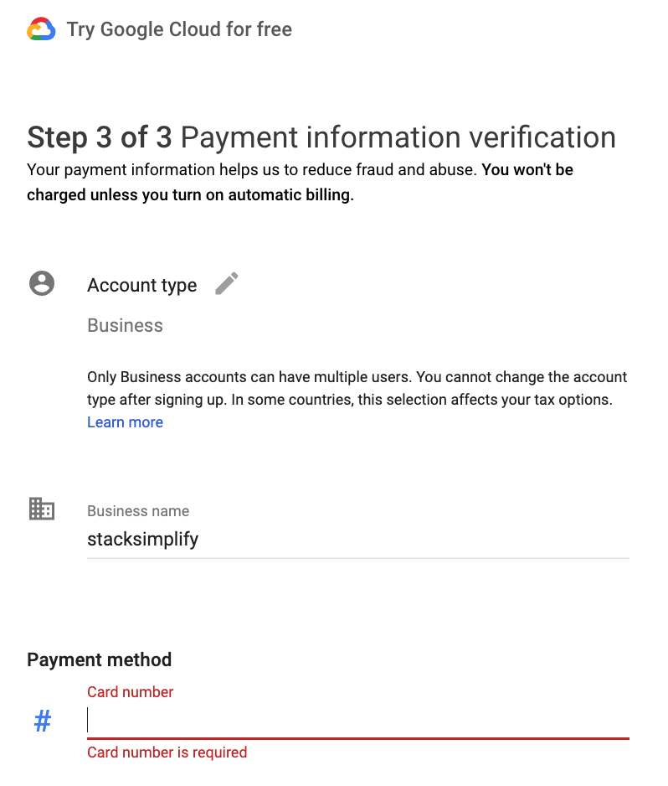
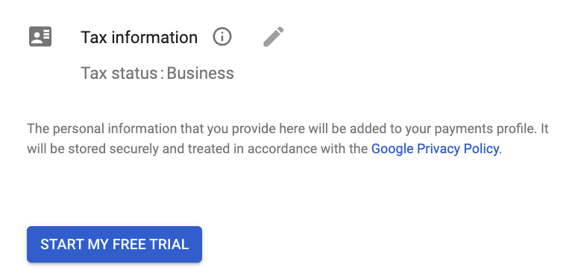
Google Cloud Account - Business

Slide 6
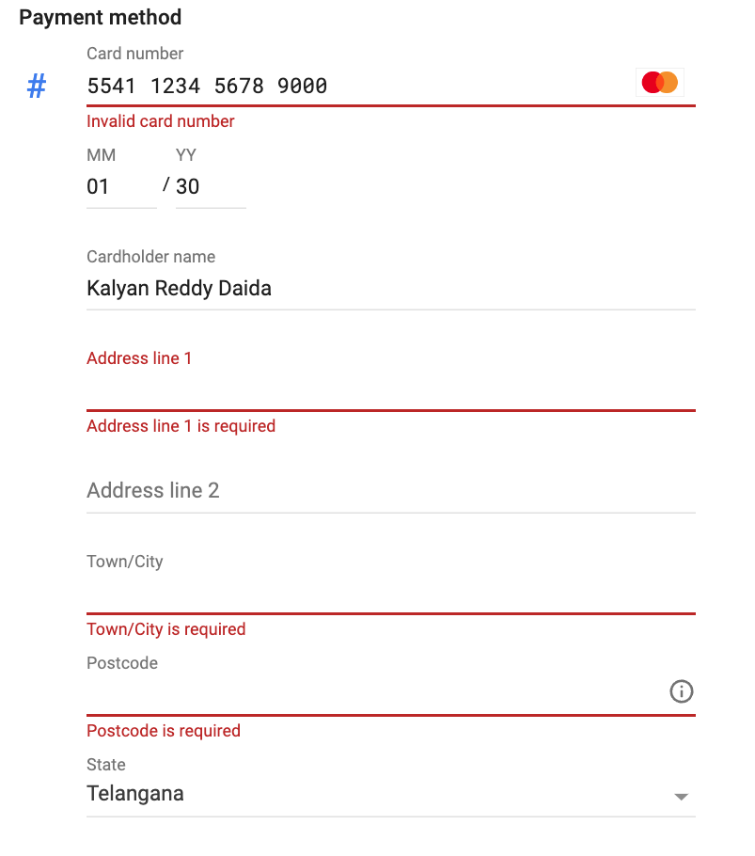
Google Cloud Account
Provide Address Details

Slide 7
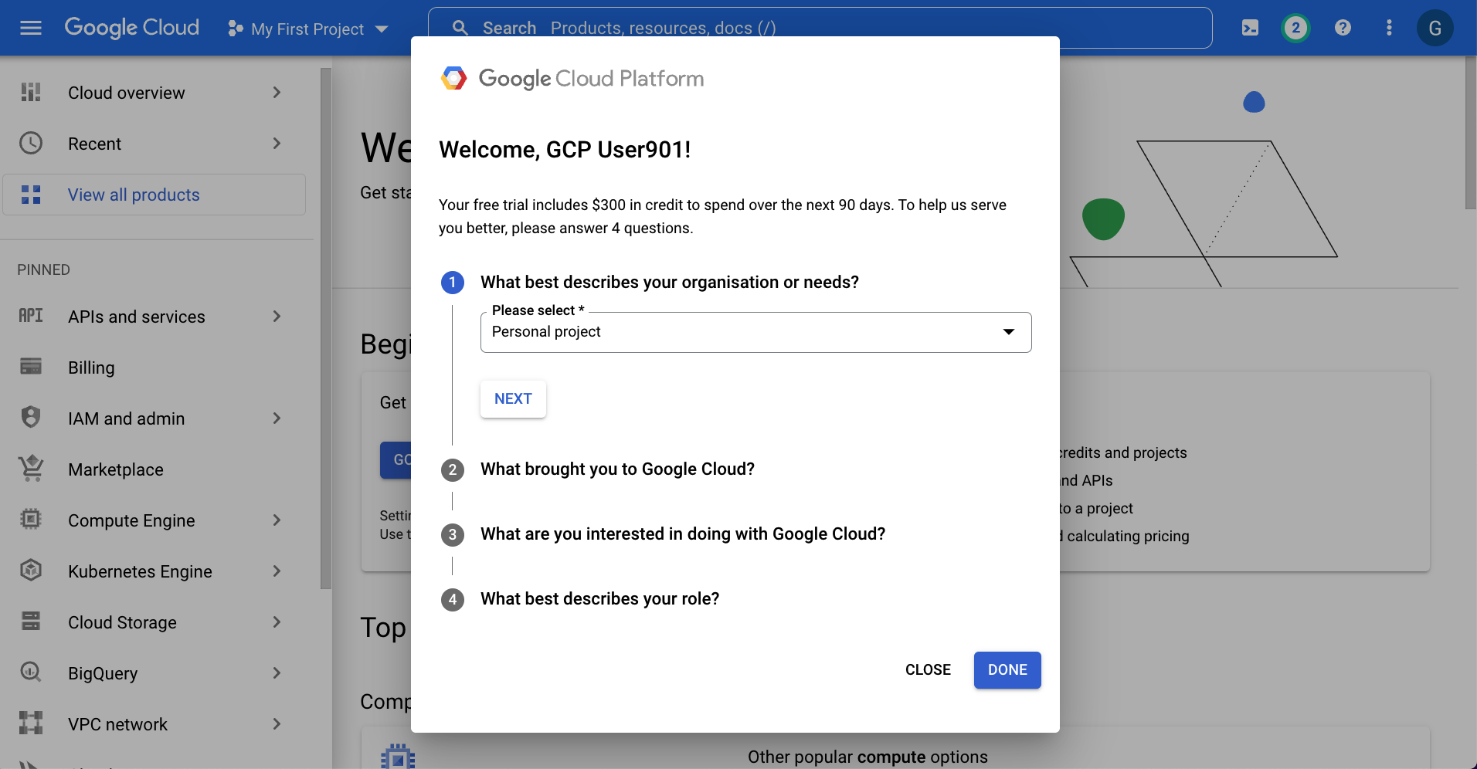
Google Cloud Account

Slide 8
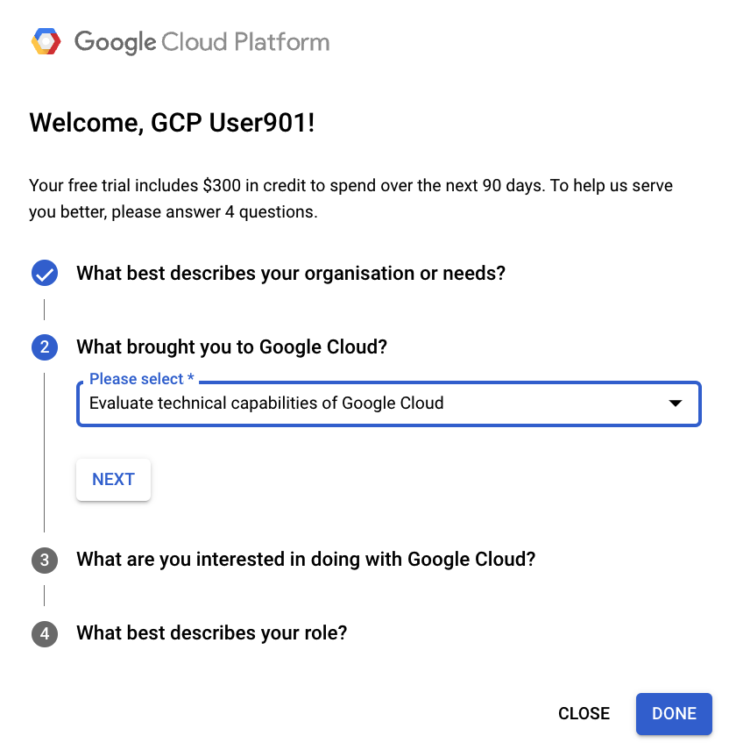
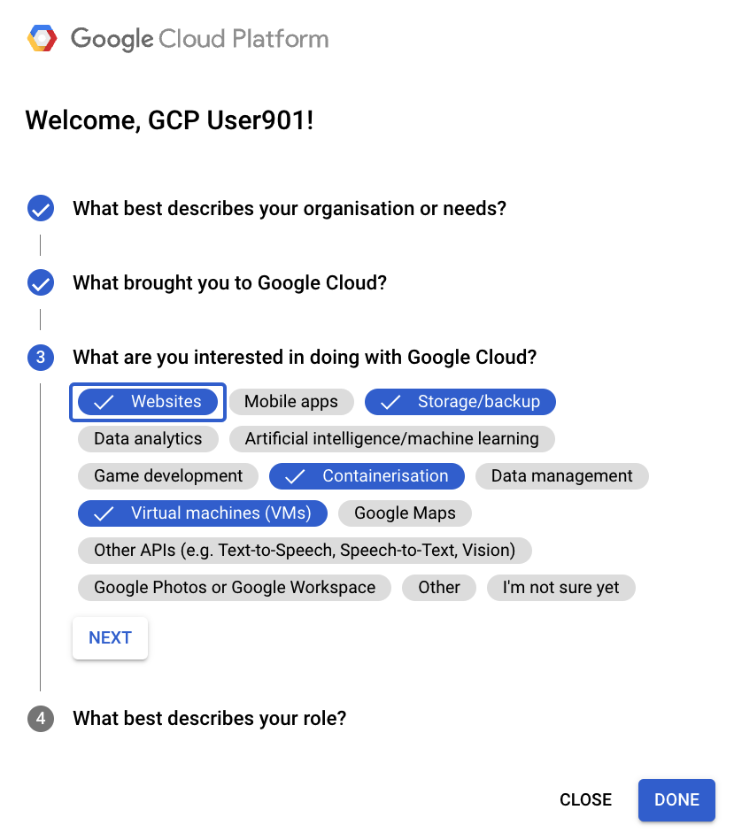
Google Cloud Account

Slide 9
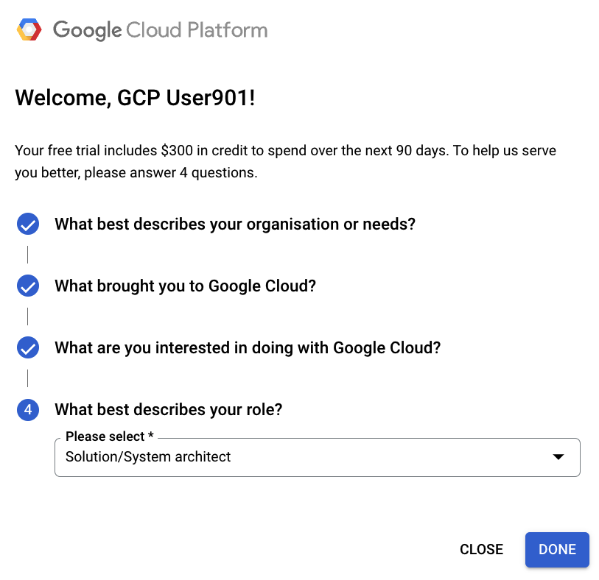
Google Cloud Account

Slide 10
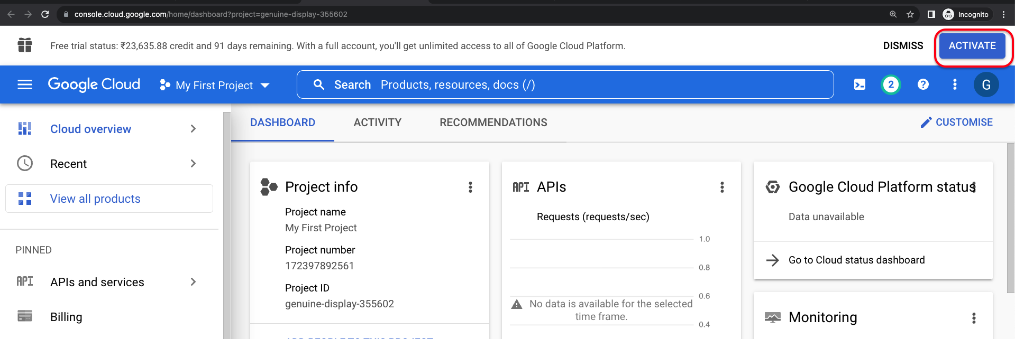
Google Cloud Account - ACTIVATE

Slide 11
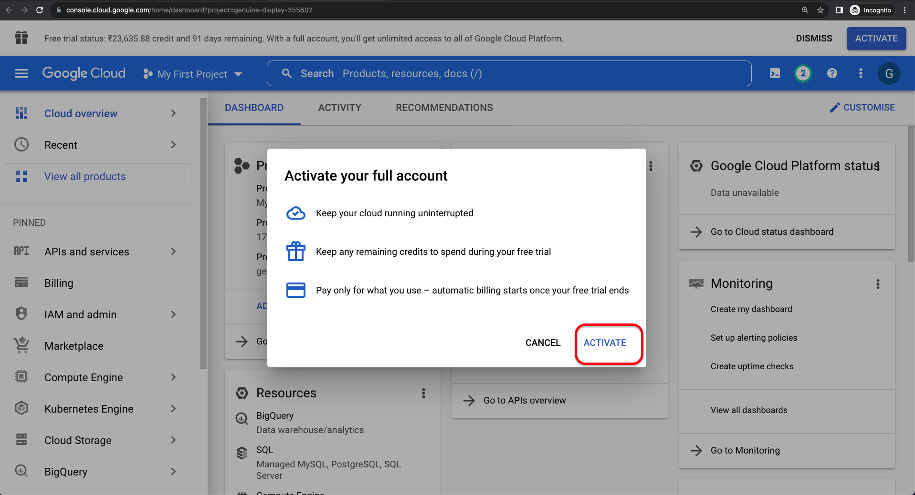
Google Cloud Account - ACTIVATE

Slide 12
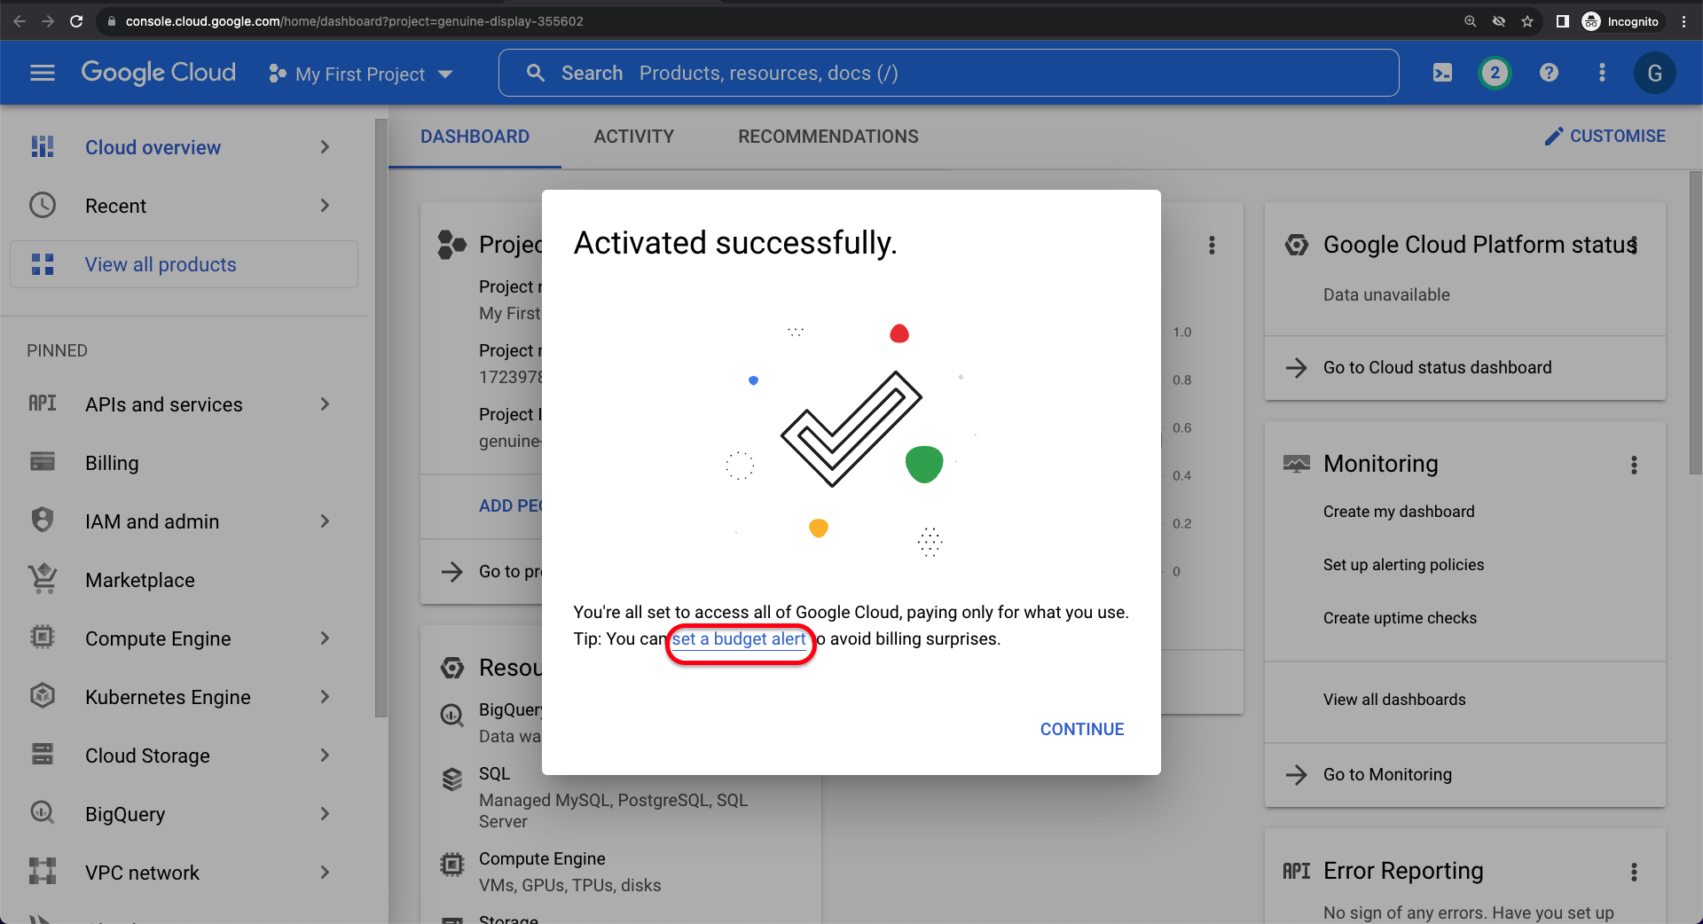
Google Cloud Account –Set a Budget Alert

Slide 13

Google Cloud
Create Budget Alerts

Slide 14
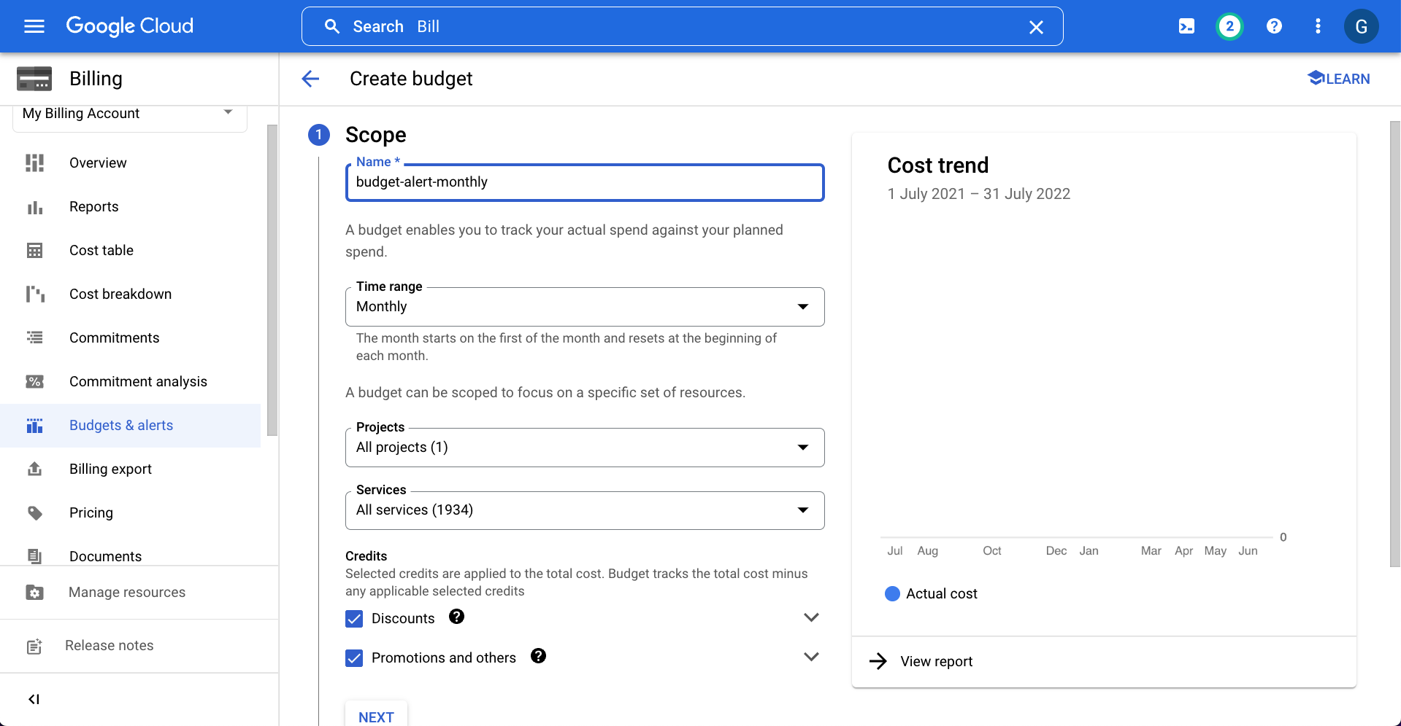
Google Cloud Account - Create Budget Alerts

Slide 15
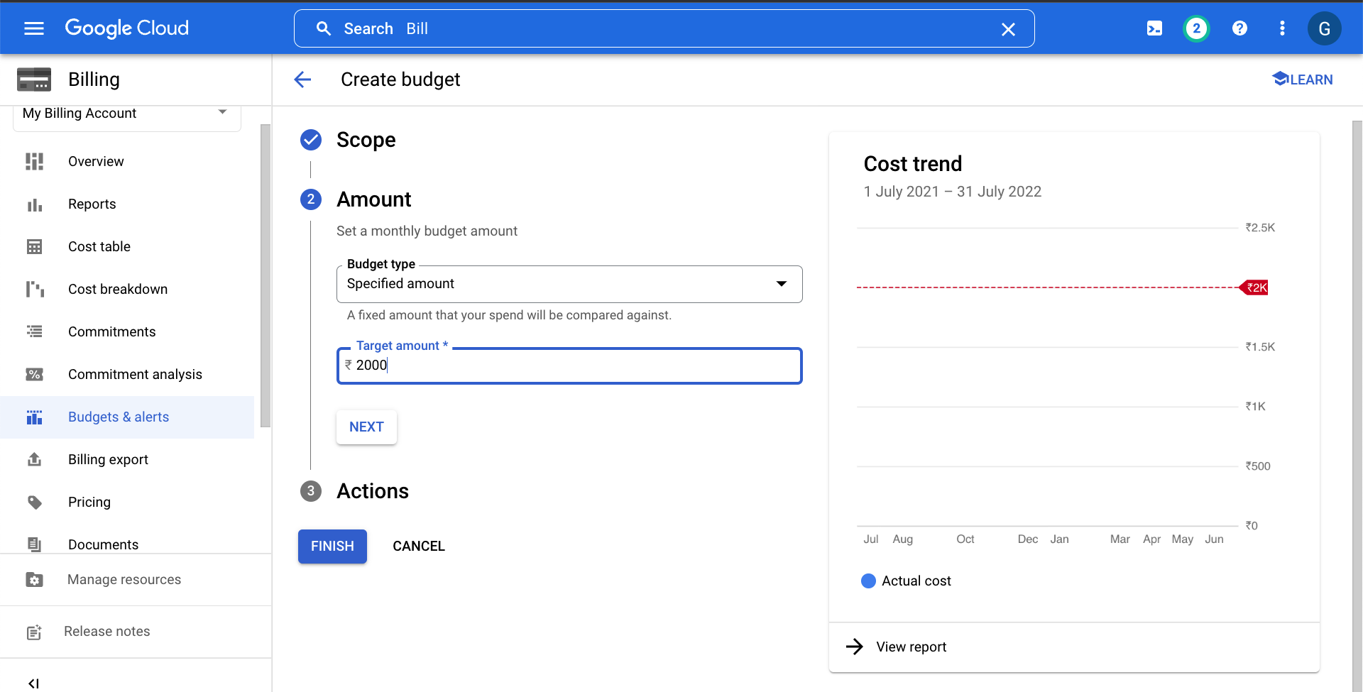
Google Cloud Account - Create Budget Alerts

Slide 16
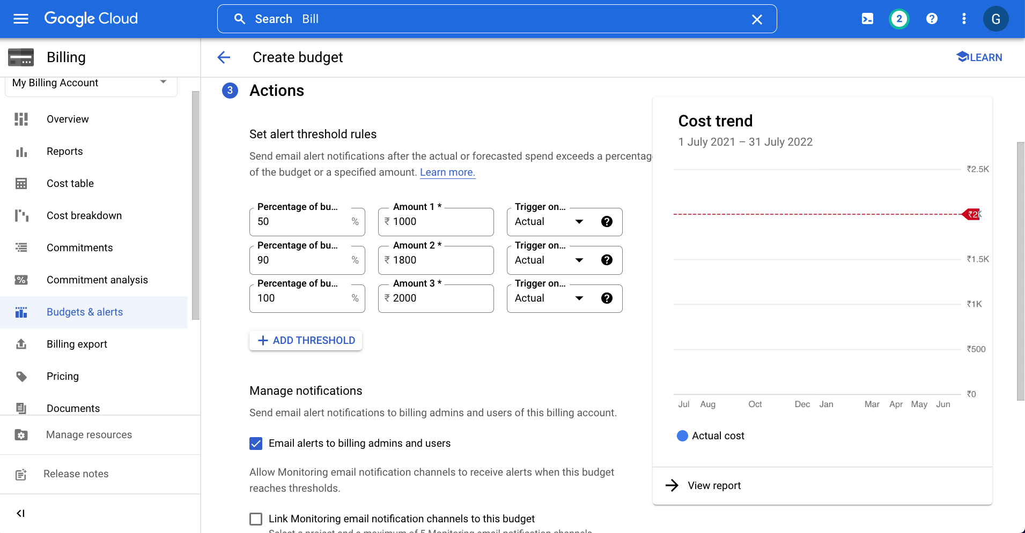
Google Cloud Account - Create Budget Alerts

